Slide 1

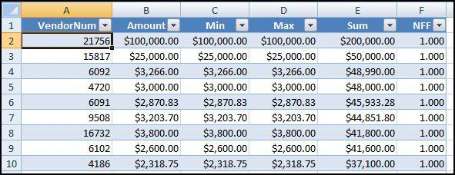
Chapter 12
Duplications within subsets
Can use Access or Excel
Exact duplicates: Same-same-same
Close duplicates: Same-same-different
Prepared by:
Mark J. Nigrini
Copyright © 2012 by Mark J. Nigrini. All rights reserved.
Notes:
Pages 233 to 262.
Tests identify exact duplications, near duplications, and duplications within subsets.

Slide 2
introduction
Tests assume that excessive duplications are red flags for fraud or errors
Need to define abnormal duplication
Exact duplicates: Same-same-same
Close duplicates: Same-same-different
Subset duplications → high risk of fraud or errors
Notes:
Page 233.

Slide 3

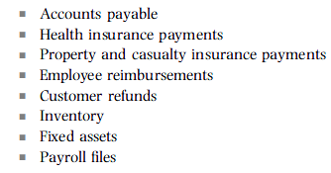
same-same-same
Notes:
Page 234.
Financial managers often assert that their systems have built-in checks for duplicate payments. Even if this is so, it is still important to actually test the controls. Duplicate payments could be frauds and are more likely to occur when the company has just started a new fiscal year, has changed AP systems, or has acquired an entity and assumes responsibility for the AP function after date of acquisition. One international conglomerate had several unconnected SAP systems used for accounts payable. It was very possible that one system processed the payment correctly and that payment was duplicated on another one of the systems.

Slide 4

same-same-different
Notes:
Page 235 and 236.

Slide 5
ssd notes
Effective for accounts payable errors
Finds where wrong vendor is paid first
Higher risk when vendors have many #s
Adapt the test for very large files
Leads the way for system improvements
Finds where payments are made to same vendor from different processing centers
Notes:
Page 235 and 236.

Slide 6


subset number duplication
Notes:
Page 236 to 238.
The Subset Number Duplication (SND) test identifies excessive number duplication within subsets. This test works well in situations where excessive number duplication might signal that the numbers have been invented which might be a red flag for fraud.

Slide 7
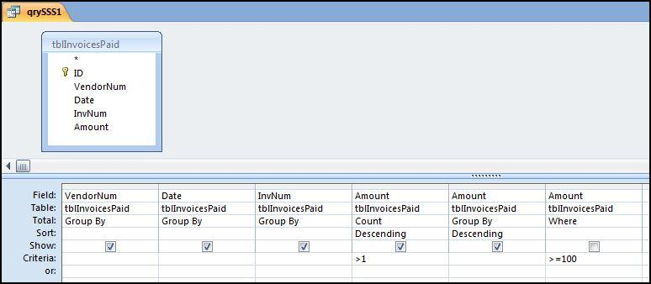
sss: access
Notes:
Page 238.
Figure 12.1.
Access has a Find Duplicates Query Wizard which works well for this reasonably straightforward test. A problem with this wizard is that the duplicates are shown on two lines, and the triplicates on three lines and so forth. This causes a very large results table for large data sets. The preferred method is to use Group By routines that will be good practice for other similar tests.

Slide 8
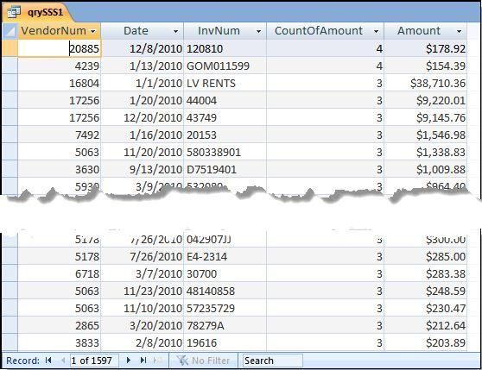
sss: access
Notes:
Page 239.
Figure 12.2.
The results in Figure 12.2 show a large number of duplications. The results are sorted by the Count descending and then by the Amount descending. Amounts less than $100 are not included in the results to keep the results table to a manageable size.

Slide 9
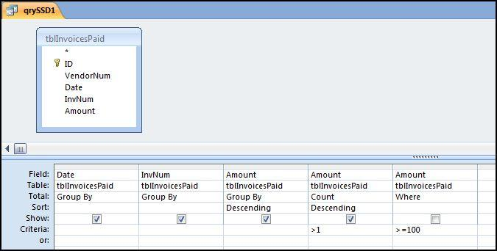
ssd: access
Notes:
Pages 239 to 244.
Figure 12.3.
Access has a Find Unmatched Query Wizard that works reasonably well for the same-same-different test. A problem with this wizard is that we get some strange results when we have a group of three invoices with two of them being for the same vendor and the third invoice being for a different vendor.
The first query identifies all the cases where we have the same Amount, the same Date, and the same InvoiceNum. The VendorNum field will be used in the next query.
The results show that we have 2,111 cases where we have the same Date, the same InvoiceNum, and the same Amount. In some of these groups the vendors will be the same (in which case we have the results in our prior SSS test) and in some cases the vendors are different (in which case they're exactly what we're looking for in this SSD test).
The next series of queries (not shown) identifies those cases where the vendors are different.

Slide 10
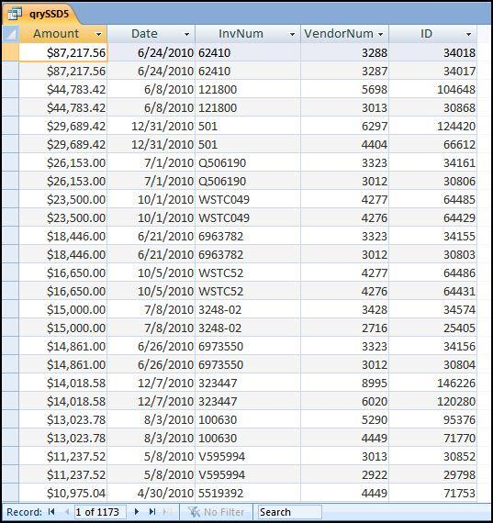
SSD: access
Notes:
Pages 242 to 244.
Figure 12.9.
The results of the SSD test shows many possible recoverable errors. The sum of the Amount field for all 1,173 records is $1.65 million and on the basis that one payment is probably correct and the other payment in each group is possibly an error we have identified about $800,000 in possible recoverable overpayments. In one case we have a duplication of $23,500 with invoice WSTC49 and a duplication of $16,650 with invoice number WSTC52. These errors seem to be related and it seems that accounts payable personnel might be making several errors between two similar looking vendors. These errors are easy to make when a vendor is perhaps an international conglomerate with different divisions operating out of the same building (hence the same street address), using the same stationery, and selling very similar products.
If the invoice image can be easily retrieved then identifying the errors is made much easier.

Slide 11
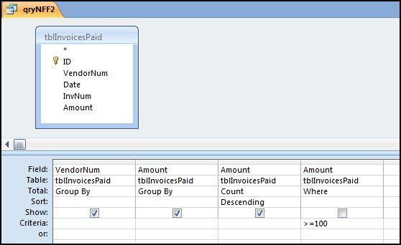
snd: access
Notes:
Pages 244 to 248.
Figure 12.11.
The 2nd query starts the work needed to calculate the NFF values using the formula in equation 12.01. The first step is to count how many times each different amount is used in a subset and this query is shown in Figure 12.11.

Slide 12
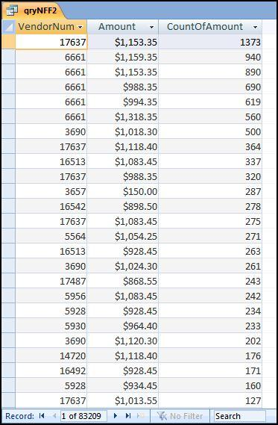
snd: access
Notes:
Pages 245 to 246.
Figure 12.12.
Figure 12.12 shows the duplications within the subsets. These results tie in with some previous findings. The first-two digits test showed that we had an excess of number with first-two digits 50, 11, 10, 98, 90, and 92 with a slightly smaller spike at the psychological threshold of 99. The results in Figure 12.12 show many numbers with these first-two digits. The results highlight the exact numbers and also indicate that many of these duplications occurred in the same subset.

Slide 13
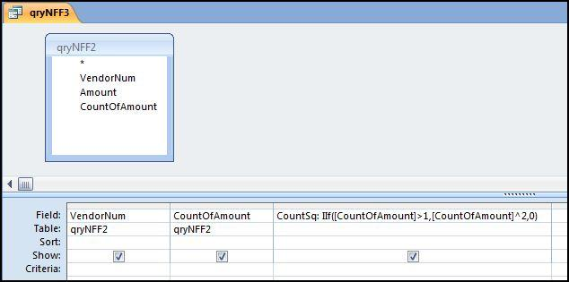
snd: access
Notes:
Pages 245 to 246.
Figure 12.13.
To calculate the NFF we need to square the CountOfAmount when the count is larger than 1 for the c² term in the numerator of equation 12.01. This condition requires the use of the Immediate If function and the query is shown in Figure 12.13.

Slide 14
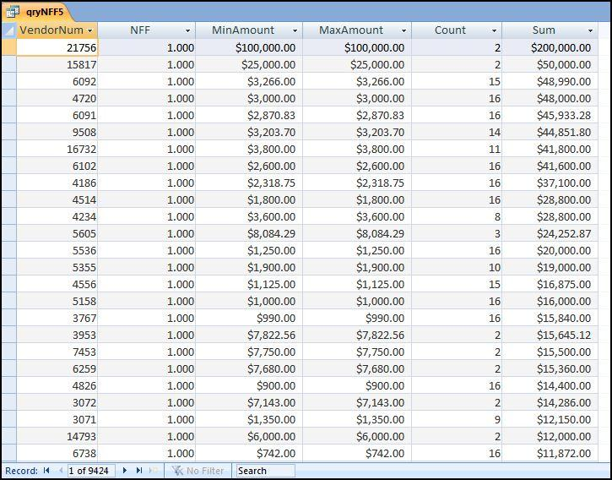
snd: access
Notes:
Pages 246 to 248.
Figure 12.16.
More calculations are needed to sum the counts-squared and then to calculate the NFF. Queries use calculated fields and some logic to sort the results.
The results of the SND test are shown in Figure 12.16. Those subsets with a NFF of 1.00 are shown at the top of the list. There are 311 subsets with NFFs equal to 1.00. This is a large list to scan and audit. The secondary sort is by Sum descending. The results where the Count equals 2 are not terribly interesting and qryNFF5 could be updated to omit these subsets in the final results. Also, subsets with NFFs equal to zero (meaning that all the numbers were different) could also be omitted from the results.

Slide 15
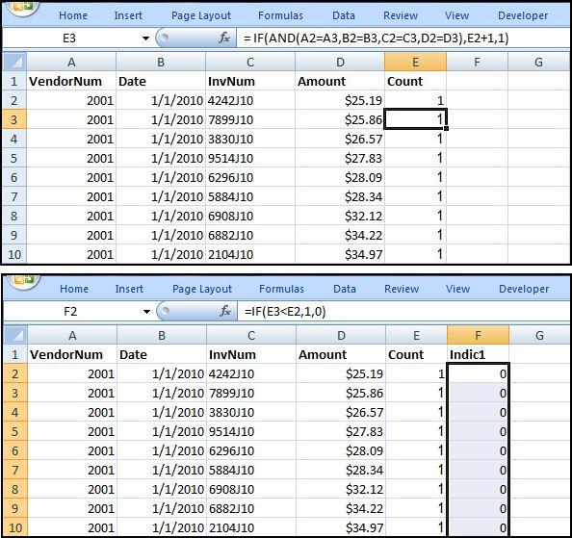
sss: excel
Notes:
Pages 248 to 251.
Figure 12.17.
The preferred approach is to use indicator variables.
The first step is to sort the data by VendorNum, Date, InvNum, and Amount ascending (smallest to largest). Once this is done, the first series of formulas to run the test are shown in Figure 12.17.
The formula in column E is basically a counter that counts how many times a row has been duplicated. The formula in column F indicates when the highest number in the series has been reached.

Slide 16
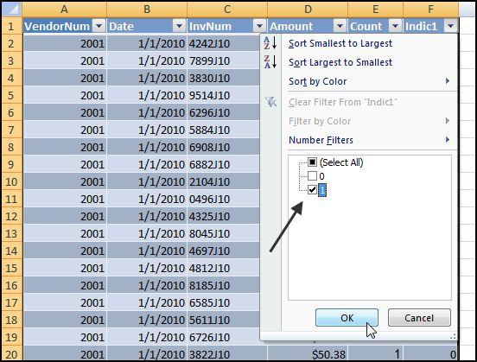
sss: excel
Notes:
Pages 248 to 251.
Figure 12.18.
The remaining tidying up steps convert the data to a table. Click Insert→Tables→Table. Excel automatically senses the location of the data. Click OK. The filter is activated by clicking on the drop-down arrow in Indic 1 and we can now use a filter as is shown in Figure 12.18.

Slide 17
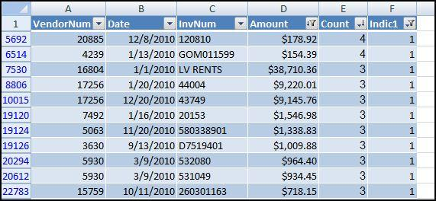
sss: excel
Notes:
Page 251.
Figure 12.20.
After another filter to keep only the records >= $100, the results are as is shown in figure 12.20.

Slide 18
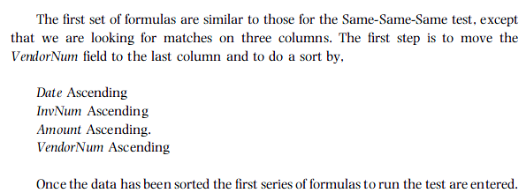
ssd: excel
Notes:
Pages 252 to 256.
We are looking for cases where we have same date, same invoice number, same amount, and different vendors. this will happen when we have matches in columns A, B, and C and a mismatch in Column D.

Slide 19
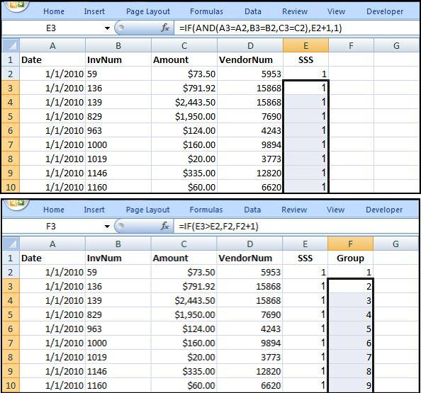
ssd: excel
Notes:
Pages 252 to 253.
Figure 12.21.
The SSS (for same-same-same) indicator in column E starts a count for the number of same-same-same cases ignoring the Vendor field. A count of 2 or more in the SSS field means that we have one or more duplicates. The Group field in column F signals starts numbering the groups with a 1, 2, 3, and so on. If group #78 has 4 records the formula would show 1, 2, 3, and 4 on four successive rows.

Slide 20
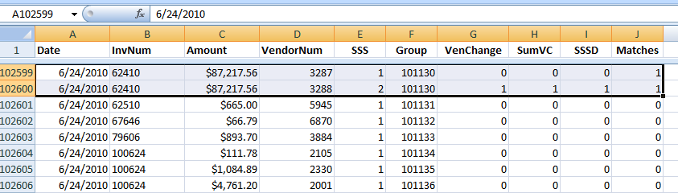
ssd: excel
Notes:
Pages 252 to 256.
Figure not in book.
The extract from the Excel file shows two successive rows that are identified as being SSD.
SSS counts 1 and 2
Group is the same
VenChange indicates that there is a change in the vendors
SumVC just makes sure that there is an indicator on the same row as the last record for a group if that group has a vendor change.
SSSD has the formula to make sure that we only have an indicator in the last row of any group of interest.
Matches uses a formula to places indicators (“1”) in all the rows of any group of interest
We then tidy up by filtering on J (which shows SSSD) and Amount (to show only material dollar amounts).

Slide 21
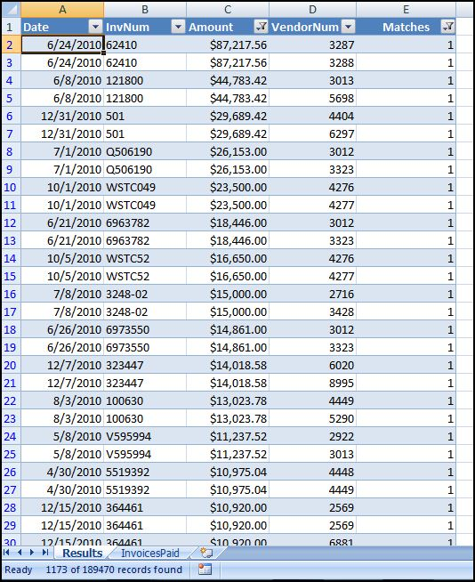
ssd: excel
Notes:
Page 256.
Figure 12.26.
To tidy up the result we should format the worksheet as a table using Home→Styles→Format As Table→Table Style Medium 2.
The final step is to filter on Matches =1, and Amount ≥ 100.00 to give the result in Figure 12.26.

Slide 22
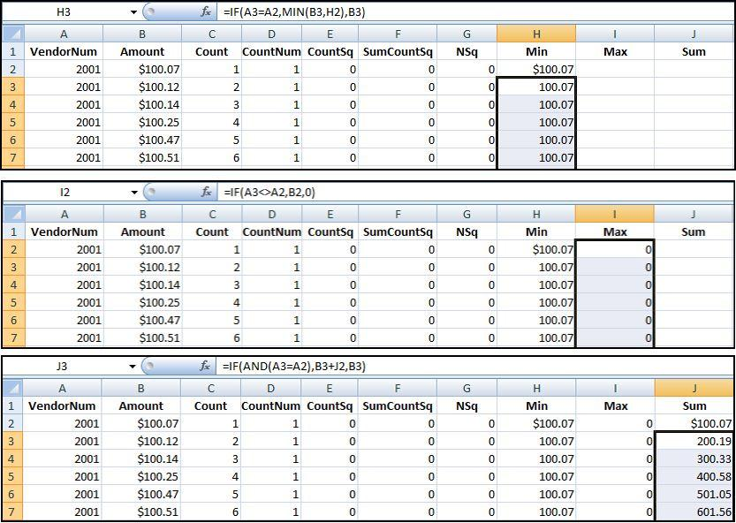
snd: excel
Notes:
Pages 256 to 262.
Figure 12.31.
The first step is to delete all records less than $100.
The next step is to delete the Date and InvNum fields. These are not used for these calculations and our worksheet will have a neater format and smaller file size.
The next step to begin the calculations is to resort the data by
VendorNum Ascending, and
Amount Ascending
C counts the number of records in each subset
D look for duplicate numbers
E squares the counts
F sums the squared counts
G squares the count for each subset
H, I, and J (above) calculates some descriptive statistics for each subset.
K (not shown) is used to calculate the NFF and L (not shown) is used to indicate when we have the last record for a subset.

Slide 23
snd: excel
Notes:
Pages 262.
Figure 12.33.
We need some tidying up which includes deleting the columns that are no longer needed. We also only show the rows where EndSub = 1.
to finish tidying up the table has been formatted using Home→Styles→Format As Table with a Table Style Medium 2 applied. This style automatically adds the filters on the first row.
The NFF results are shown in Figure 12.33. The results can be saved to a file for the forensic working papers or the results could be e-mailed to accounts payable or corporate risk personnel for follow-up work. It is probably a little more complex to run this test in Excel.

Slide 24
abnormal dups summary
Excessive duplications are red flags for fraud or error
Unusual to charge $113.64 twice on the same day
Same-same-same could be a split purchase or an election tally error
Same-same-different looked for near duplicates
Subset duplication could signal errors
Tests can be run in Access or Excel
Notes:
Page 262, and a review of the main points in the chapter.

